Slide 1
We’re kind and outward-looking: learners today, leaders tomorrow.

Slide 2
Maths Mastery Workshop
Wednesday 29th September 2021

Slide 3
First, let’s warm up our maths brains with a quick game of PING-PONG
I say “PING!” You say “PONG”
I say “PONG” You say “PING!”

Slide 4
Today’s Aims
• Understand what the ‘Maths Mastery’ approach is.
• How we use the Mastery approach to guide our teaching of Maths at Plumpton.

Slide 5
What is mastery?
Mastering maths means pupils acquire a deep, long-term, secure and adaptable understanding of the subject.
Teaching maths for mastery involves employing approaches that help pupils to develop a deep and secure knowledge and understanding of mathematics at each stage of their learning, so that by the end of every school year or Key Stage, pupils will have acquired mastery of the mathematical facts and concepts they’ve been exposed to, equipping them to move on confidently and securely to more advanced material. Charlie Stripp, Director NCETM, 2016

Slide 6
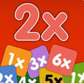
What does a Maths Mastery lesson look like?
A typical Maths mastery lesson is led by the teacher, with all of the pupils in the class working together on the same tasks at the same time. The pace of the class is governed by the children, giving them time to revisit key concepts frequently throughout the lesson.
There’s a mixture of short tasks, explanation, demonstration and discussion – and a lot of practice to help reinforce children’s learning. There is a focus on mathematical vocabulary.
Children are also expected to learn key maths facts like times tables and addition facts by heart to free up working memory and give them the mental space to focus on new concepts.

Slide 7
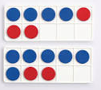
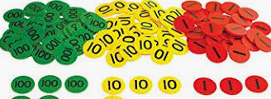
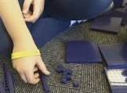
How are resources used?
Children use objects and pictures to physically represent mathematical concepts (the concrete > pictorial > abstract (CPA) approach), alongside numbers and symbols – for example, using Lego bricks to add and subtract numbers. This helps them visualise abstract ideas, and as they become more proficient, they will gradually stop relying on physical props.
EXAMPLES

Slide 8
Take a few moments to have a look at the resources laid out on the table – do you have any questions about the resources?

Slide 10
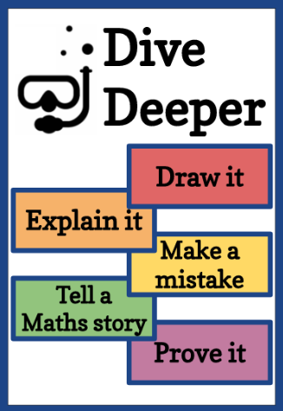
How is every child supported and challenged?
The lesson structure begins with revisiting previously taught concepts to ensure children feel confident.
New learning is introduced and children are encouraged to see connections with previous learning.
First children will practice as a whole class with their teacher and TA before all tackling the same independent task, appropriate for their year group.
Children who are ready for the next challenge will have extension and challenge tasks which dive deeper into the learning, rather than moving onto different learning or looking at the next year group learning.
Children who are finding the new learning tricky will have extra support so they grasp the concept. This will usually be the same, or following day, with their class teacher or teaching assistant.

Slide 11
Number sense and place value come first – by end of KS1 children should know numbers to 100 inside out and understand place value of tens and ones. They can apply their knowledge of numbers to 100 and solve addition, subtraction, multiplication and division problems in practical and written situations.
Problem solving is central. Children are expected to identify which of the four operations they need to use in order to solve problems. They are encouraged to select resources and draw pictures to help them solve and prove their answers.
“In mathematics, you know you’ve mastered something when you can apply it to a totally new problem in an unfamiliar situation.”
Dr. Helen Drury, Director of Mathematics Mastery

Slide 12
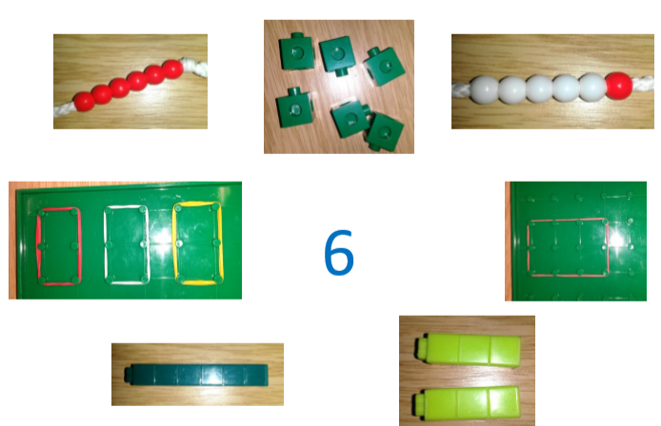
These are all different representations of 6!
We might ask children ‘What do these pictures represent?’
‘How do you know?’

Slide 13
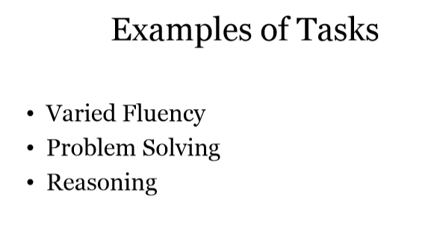

Slide 14
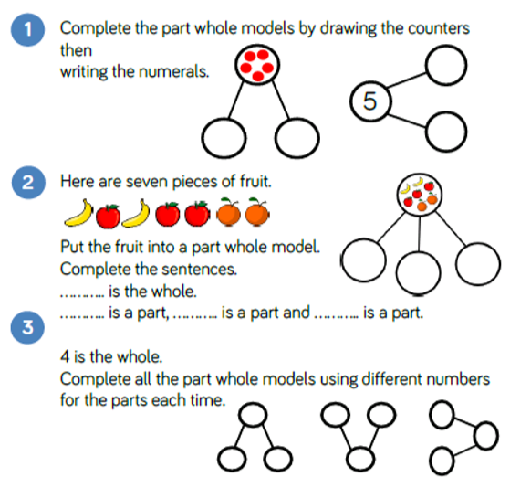
Example of Year One Fluency relating to addition
Example of a stem sentence.

Slide 15
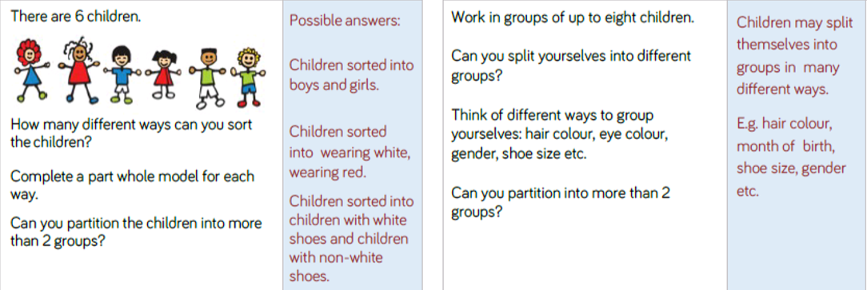
Examples of reasoning and problem solving for Year One , related to addition.

Slide 17
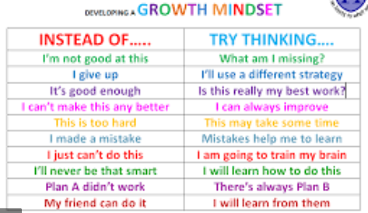
Growth Mindset
Success in mathematics for every child is possible
• Mathematical ability is not innate, and is increased through effort.

Slide 18
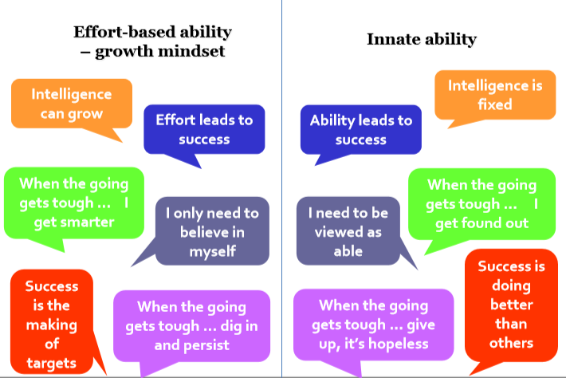

Slide 19
How can I become involved?
• Talk to your child about their learning, what have they learned in their maths lessons? Can they show you?
• Discuss numbers all around you: door numbers, bus numbers etc.
• Cooking and shopping with your child, getting them to weigh ingredients, using language such as “more” and “less/fewer”.
* Model having a growth mindset – please don’t tell them you ‘can’t/could never do maths at school’.
* Please help your children to learn their number bonds and times tables so that they can quickly recall them. This can be through the use of NUMBOTS, TTRS and/or non screen based activities.

Slide 20
Finally…
We would absolutely love you to come in and talk to the children about how you use maths in your day-to-day life and jobs.
If you would like to volunteer to be involved please let us know!
Please help yourself to the handouts and if you have any questions please do feel free to speak to your child’s class teacher or me!
Thank you for coming!

